Slide 1



The World Bank
Health & Wellness Program
Provides staff with health support, coaching, and information through a program that supplements the WBG health insurance.
Helps you improve your health by taking small, consistent steps towards healthier behaviors.
Available to all HQ and Country Office staff, retirees, and eligible dependents age 18 and older.
An online wellness portal (www.connectwithyourhealth.com) offers:
  Health risk assessment
  Personalized health recommendations
  Access to electronic/telephone health coaching
  Health education support through videos and written articles

Slide 2
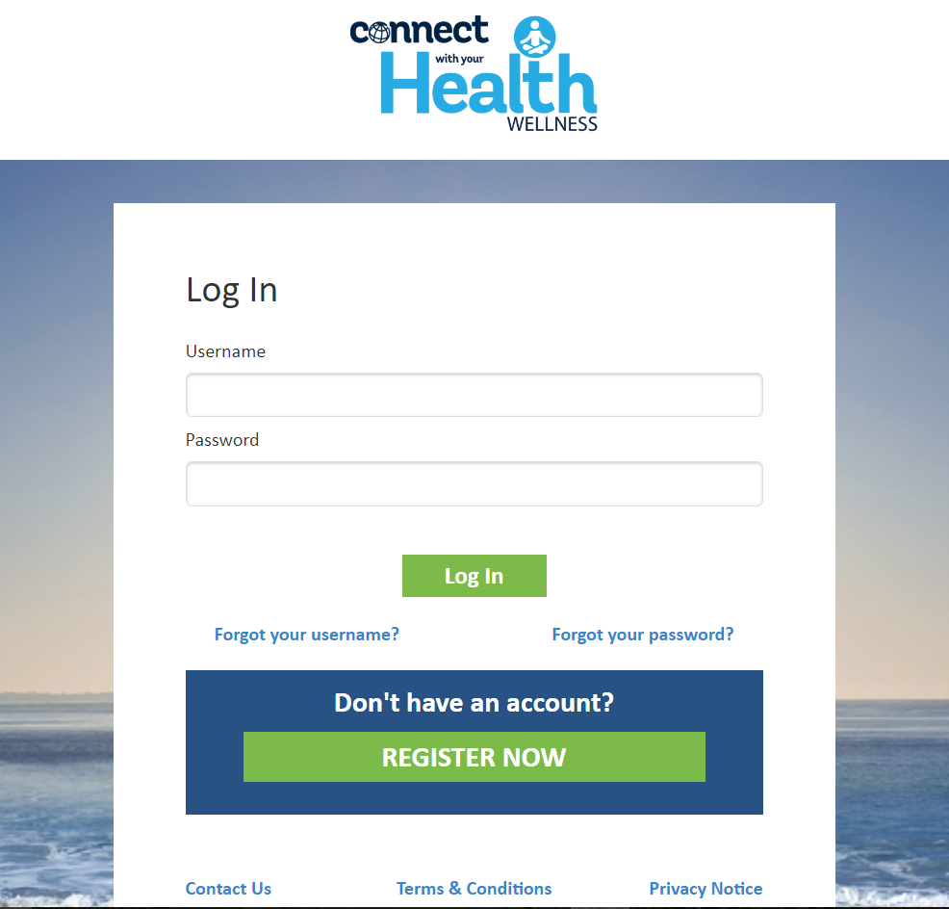
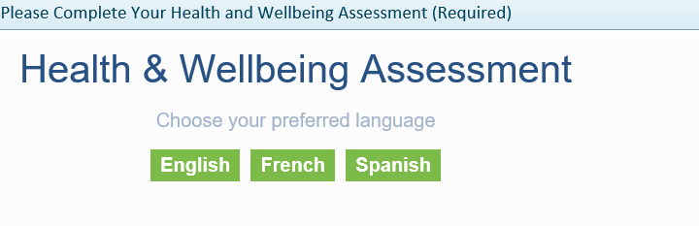
Steps to Register
Go to www.connectwithyourhealth.com and register with your name, UPI, and date of birth
Complete your Health & Wellbeing Assessment

Slide 3
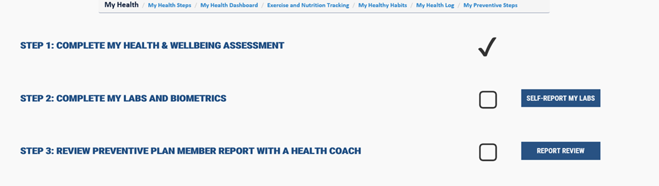
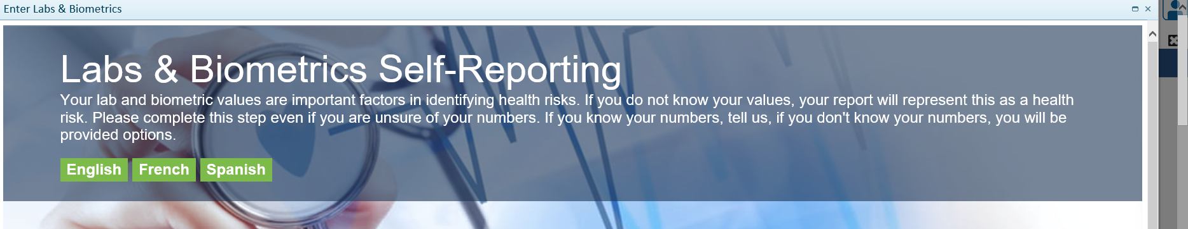
Complete your Labs & Biometrics
If not done yet this calendar year, lab work is covered 100% by the World Bank Group health insurance plan as part of preventive care
    blood draw for cholesterol (total, HDL, LDL, triglycerides)
    blood sugar (blood glucose) levels
    biometric measurements: height, weight, waist circumference, and blood pressure.
Enter these results in the self-reporting tool (strictly confidential and not shared with the WBG)

Slide 4

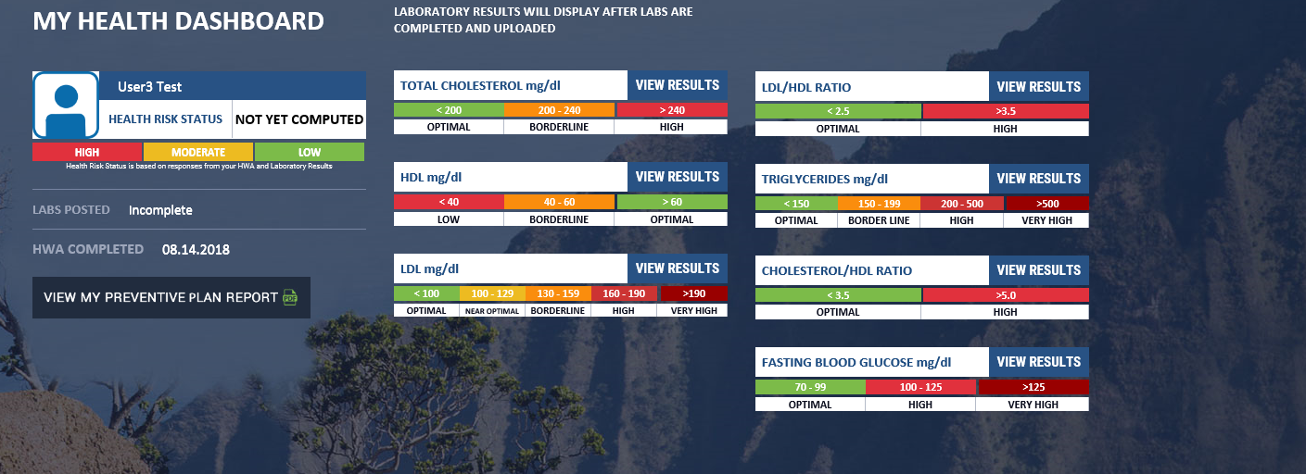
Receive your Preventive Plan results which will outline health risks and provide recommendations, review with a Health Coach if desired

Slide 5
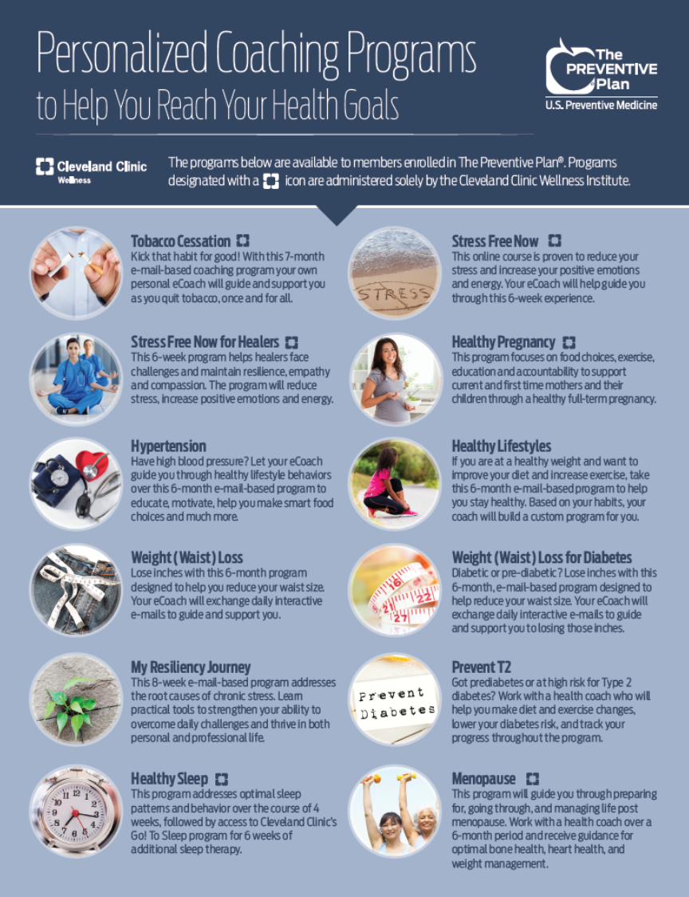
What is Next?
Bring the Preventive Plan to your doctor to discuss recommendations and work together towards making improvements.
Sign up for a health coaching program for ongoing support (also covered as part of the Health & Wellness Program).

Slide 6
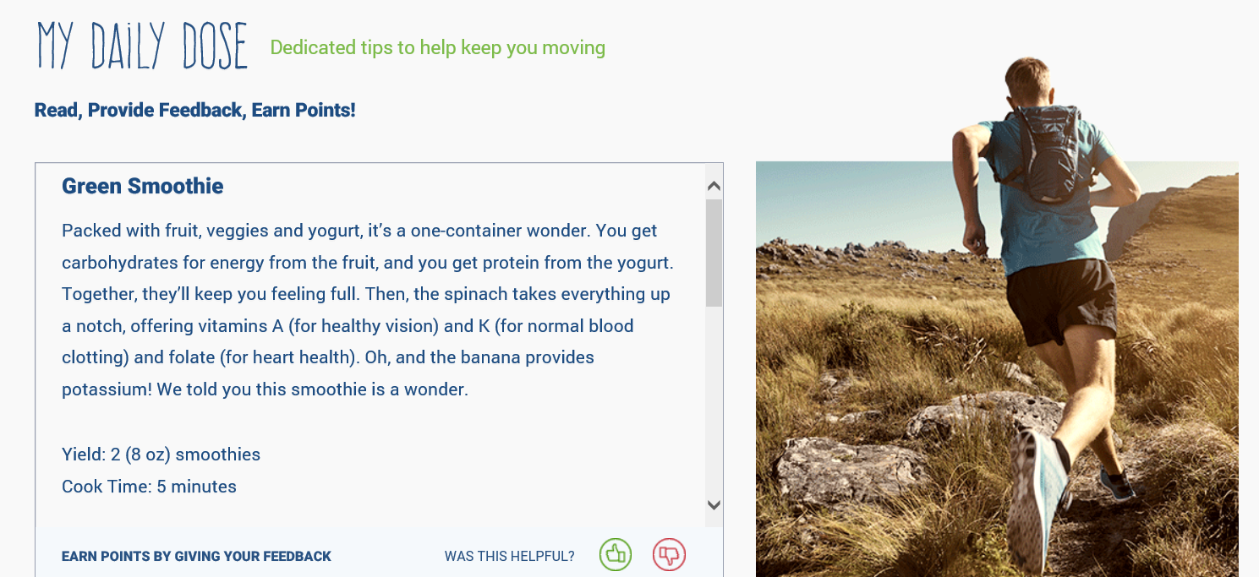
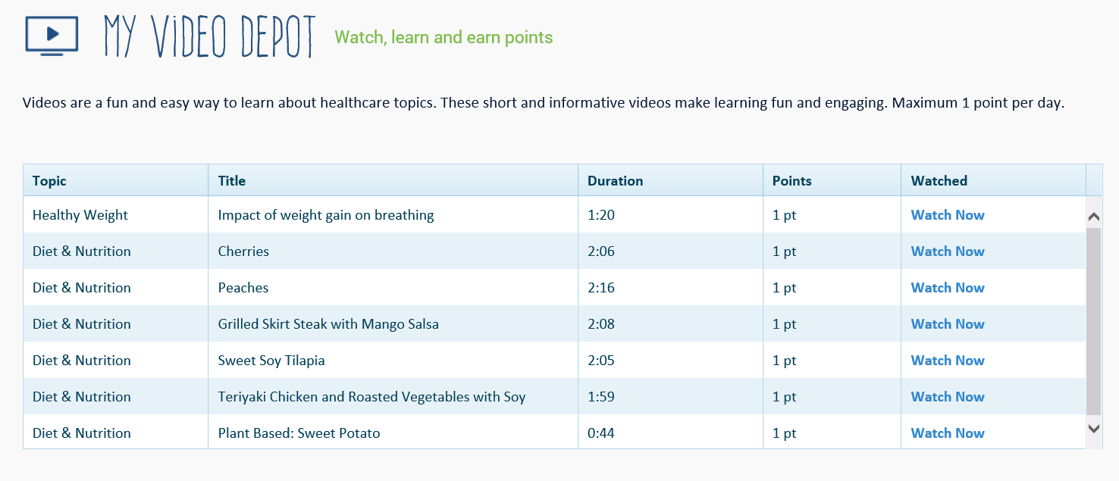
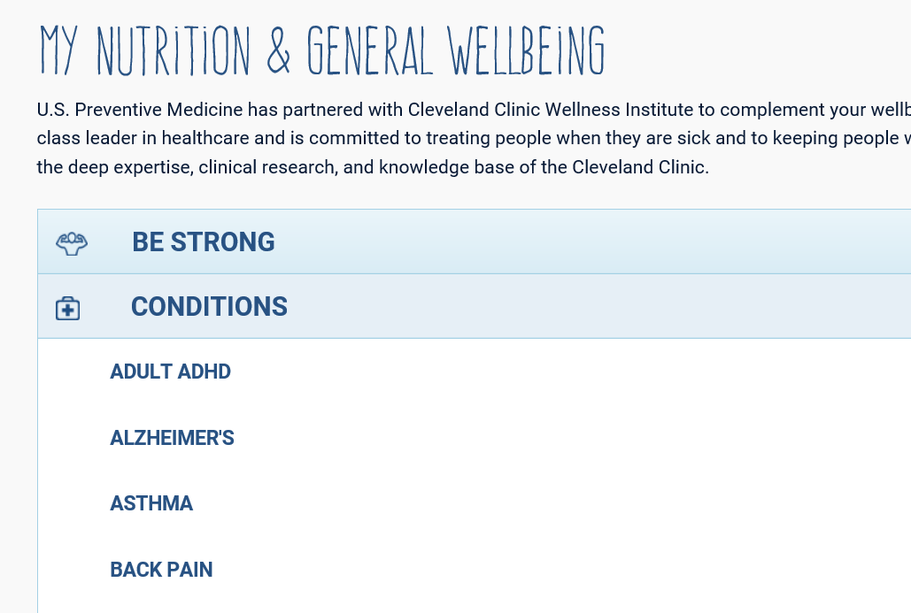
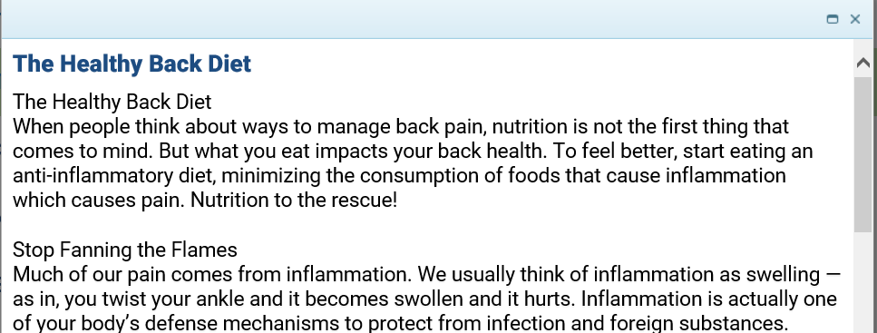
What is Next?
Take advantage of the Portal Resources:
Learning Programs
Daily Healthy Tips
Video Library
Health Library
If you have any problems at any stage of the process, please call:
866.713.1180
or email
MemberCare@USPM.com

