Slide 1
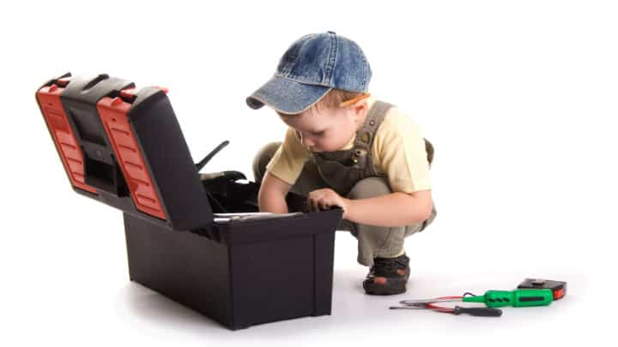
BUILDING YOUR PARENTING TOOLBOX
SESSION 3: Tools for self-drive and academic success
Diana Mayer, LCMFT

Slide 2
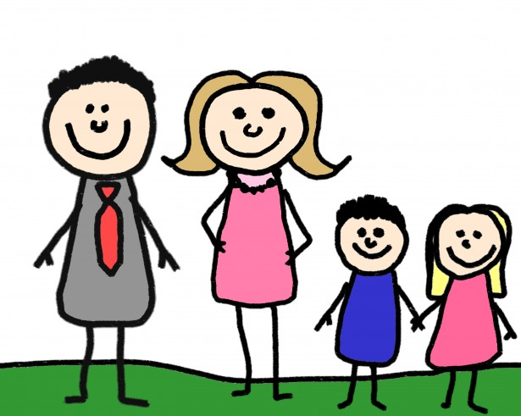
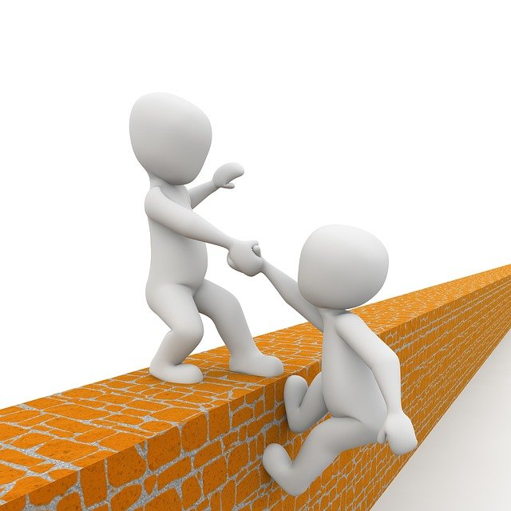
HOW DO YOU DEFINE SUCCESS?
Notes:
Understanding how our brain is wired to regulate emotions, helps parents react better to their kids’ emotional outburst, and helps kids understand themselves better. It empowers them to take charge!
The brain is an incredibly complex organ; we’ll focus only in two parts of the brain: The Amygdala, and the Pre-Frontal Cortex (use hand gesture to represent). The Amygdala is the “alarm system” of the brain; it reacts to perceived danger and automatically responds with fight, flight, or freeze response (give examples of bear on hike and how Amygdala automatically makes us run or play dead. We don’t want to engage in conversation with the bear). The Pre-Frontal Cortex (PFC) or “smart part of the brain”, is what we use to problem solve and think-things through (executive function). When the Amygdala gets triggered, it highjacks or disconnects the PFC. Because of that, when a child reacts to perceive danger (fear or anger), that child is not processing information properly or thinking clearly about his behavior.
***The only way to engage the PFC is to sooth the Amygdala first!

Slide 3
FALSE ASSUMPTIONS (Stixrud & Johnson)
There is a narrow path to success
To do well in life, you have to do well in school
Pushing more will lead to more accomplishments and higher chance of success
The world is more dangerous than ever before

Slide 4
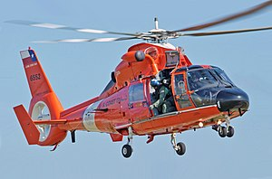
PARENTING FROM FEAR
PARENTING FROM TRUST

Slide 5
THE KEY TO SELF-DRIVE
SENSE OF CONTROL
SENSE OF COMPETENCE
SECURE BASE
CURIOSITY
FREE TIME
SENSE OF AUTONOMY
SLEEP

Slide 6
WHAT IS GETTING IN THE WAY?
PUSHING AGAINST LACK OF CONROL
ABILITY
PERFECTIONISM
HOPELESNESS

Slide 7
HOW TO?
Trust yourself and your child
Parent as a consultant: Give your child a sense of control (Stixrud & Johnson)
Prioritize the parent-child relationship over anything else
Develop and maintain collaborative relationships with other adults in your child's life
Nurture your child's self-advocacy skills
Encourage curiosity and invest time in trying new things
Growth mindset (Dweck)
Model a positive attitude towards your career
Find ways for your child to "be an expert"
Encourage your child to engage in social action

Slide 8
VOLUNTEERING IDEAS
Make something and sell. Donate profit to a cause
Collect items to donate
Tutor: Academics, sports, video games
Baby sit
Walk dog/pet sitting
Collect litter, clean trails
Advocacy
Spread awarenes

Slide 9
BOOKS
The Self-Driven Child. The Science and Sense of Giving your Kids Control Over Their Lives. William Stixrud and Ned Johnson.
How to Raise Successful People. Esther Wojcicki
The Self-Motivated Kid: How to Raise Happy, Healthy Children Who Know What They Want and Go After It (Without Being Told). Shimi Kang
Smart But Scattered: The Revolutionary "Executive Skills" Approach to Helping Kids Reach Their Potential. Peg Dawson and Richard Guare

Slide 10
Welcome - Support - Advocate
Regional Champions Onboarding
Contact the Family Consultation Service at
familyconsultationservice@wbfn.org
+1-202-458-5550
www.wbfn.org
Session 1

