Slide 1
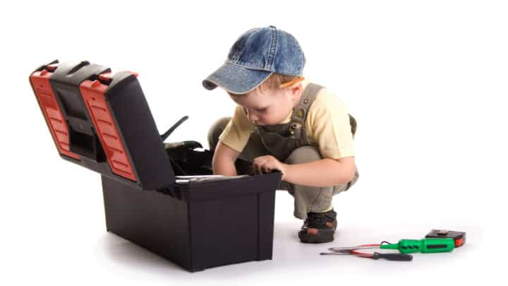
BUILDING YOUR PARENTING TOOLBOX
SESSION 2: Tools for building bonding and discipline
Diana Mayer, LCMFT

Slide 2
BONDING FIRST, DISCIPLINE SECOND
Notes:
Understanding how our brain is wired to regulate emotions, helps parents react better to their kids’ emotional outburst, and helps kids understand themselves better. It empowers them to take charge!
The brain is an incredibly complex organ; we’ll focus only in two parts of the brain: The Amygdala, and the Pre-Frontal Cortex (use hand gesture to represent). The Amygdala is the “alarm system” of the brain; it reacts to perceived danger and automatically responds with fight, flight, or freeze response (give examples of bear on hike and how Amygdala automatically makes us run or play dead. We don’t want to engage in conversation with the bear). The Pre-Frontal Cortex (PFC) or “smart part of the brain”, is what we use to problem solve and think-things through (executive function). When the Amygdala gets triggered, it highjacks or disconnects the PFC. Because of that, when a child reacts to perceive danger (fear or anger), that child is not processing information properly or thinking clearly about his behavior.
***The only way to engage the PFC is to sooth the Amygdala first!

Slide 3
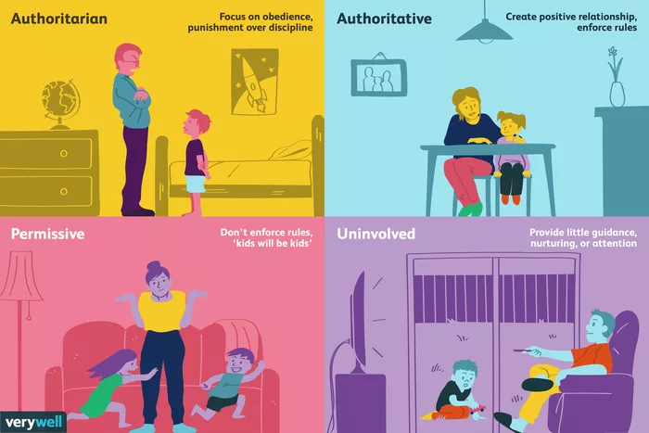
PARENTING STYLES
Notes:
As parents, it is our responsibility to teach our kids self-regulation. Because it is a skill, it has to be taught and practiced often, just like riding a bike or swimming. We can help them by teaching emotional language: identifying and naming feelings. Help them recognize how each emotion feels in the body. The Feelings Map in the following slide is a good way to do it (explanation in next slide).
There is extensive scientific evidence, that naming the feeling and connecting with empathy helps sooth the Amygdala. Because of it, when a child is showing a big emotional reaction we should approach with empathy, validation and reflecting on the feeling we see. For example: “I notice you are feeling frustrated. I can see you wanted the chocolate and mom said No, and that feels uncomfortable (say that with empathy and affection).
Because during the emotional outburst, the Amygdala is activated and the PFC disengaged, it makes no sense to try to problem solve with them or argue with their reasoning, threatening with consequences also does not help. *We need to help them sooth the Amygdala first!!! We’ll talk about strategies to sooth the Amygdala in a minute.
When your child is closer to “his Center” (reference to feelings map), his PFC is ready to problem solve and plan for the future.

Slide 4
COMMUNICATION
DEVELOPMENTAL MILESTONE
ACCULTURATION
UNDERSTANDING BEHAVIOR AS:
Notes:
The Feelings Map is an excellent tool to normalize feelings and encourage emotional conversation on a regular basis. This is how it should be explained to kids:
Lets pretend we store our feelings in our heart (brain, stomach… use whatever reference the child prefers); among all of those feelings, we all have a Center. This is where we feels relaxed, chill, comfortable with ourselves. Give examples of when you feel at Center (reading a book on the couch, going on a walk), and ask the child to give examples (playing a video game…). When at Center, our body feels relaxed and out thoughts are calm.
Around our Center we ALL have many feeling, adults and teachers too! And we constantly move away from our Center and back again. Life would be VERY boring if we would always be at Center. All of those feelings are good. The thing is that the farther away we move from our Center, the bigger the feeling gets, the harder it is to go back. Because of this, we want to pay attention to our bodies and thoughts and catch when we are moving away. We can always apply a strategy to help us get back to Center.
*Many kids will ask “why is happy bad, why be at Center if I can be happy?”, to this I answer: Happy is not bad, same as sad is not bad. All feelings are good, and we’ll experience them all. But there are times that being super happy and hyper, might not be appropriate to the situation (school, not being able to sit still during dinner). But we can strive to stay close to Center and towards yellow!

Slide 5
POWER STRUGGLE LOOPS
Identifying triggers

Slide 6
PLAN AHEAD BUT MAINTAIN FLEXIBILITY
RIGHTS VS. PRIVILEDGE
FAVOR VS. RESPONSIBILITY VS.
CHORES
NEEDS VS. WANTS

Slide 7
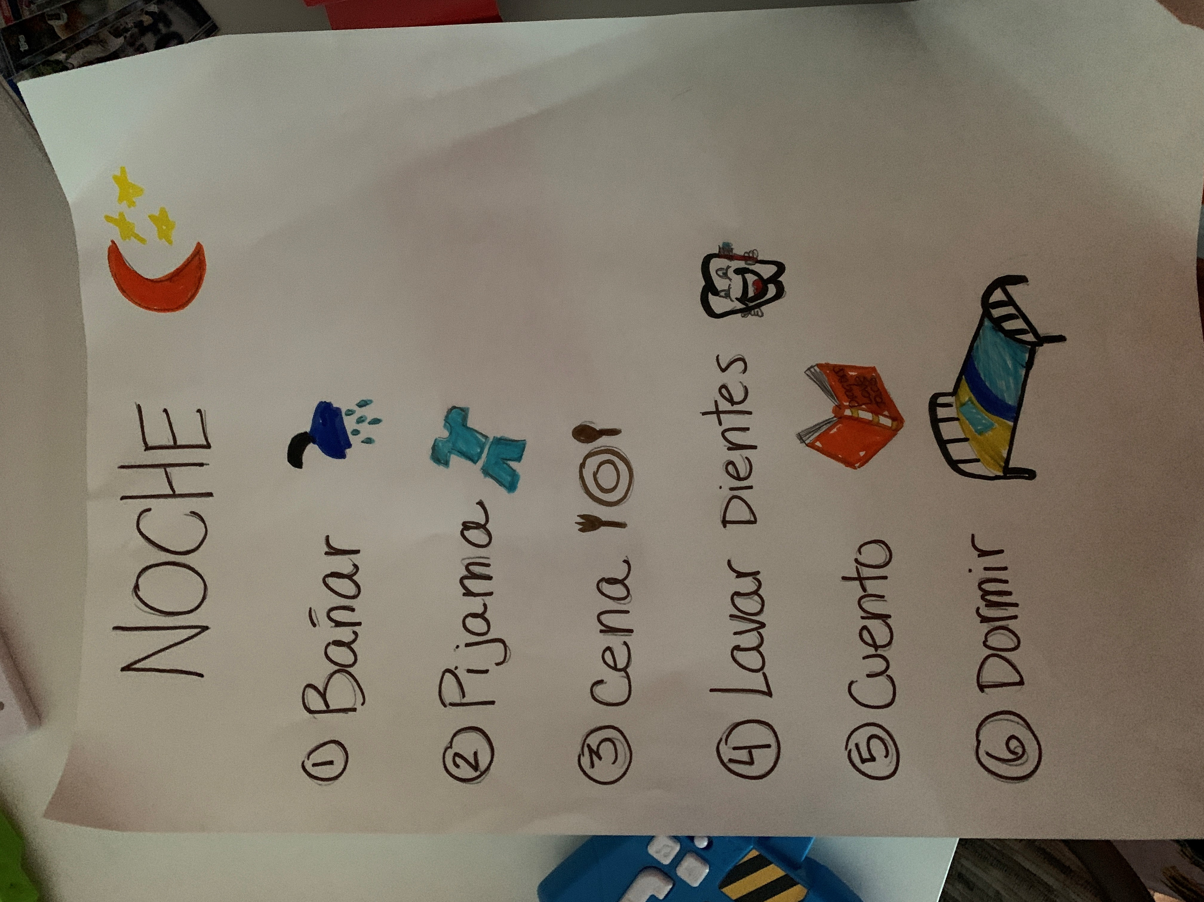
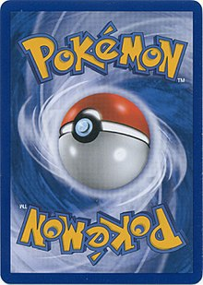
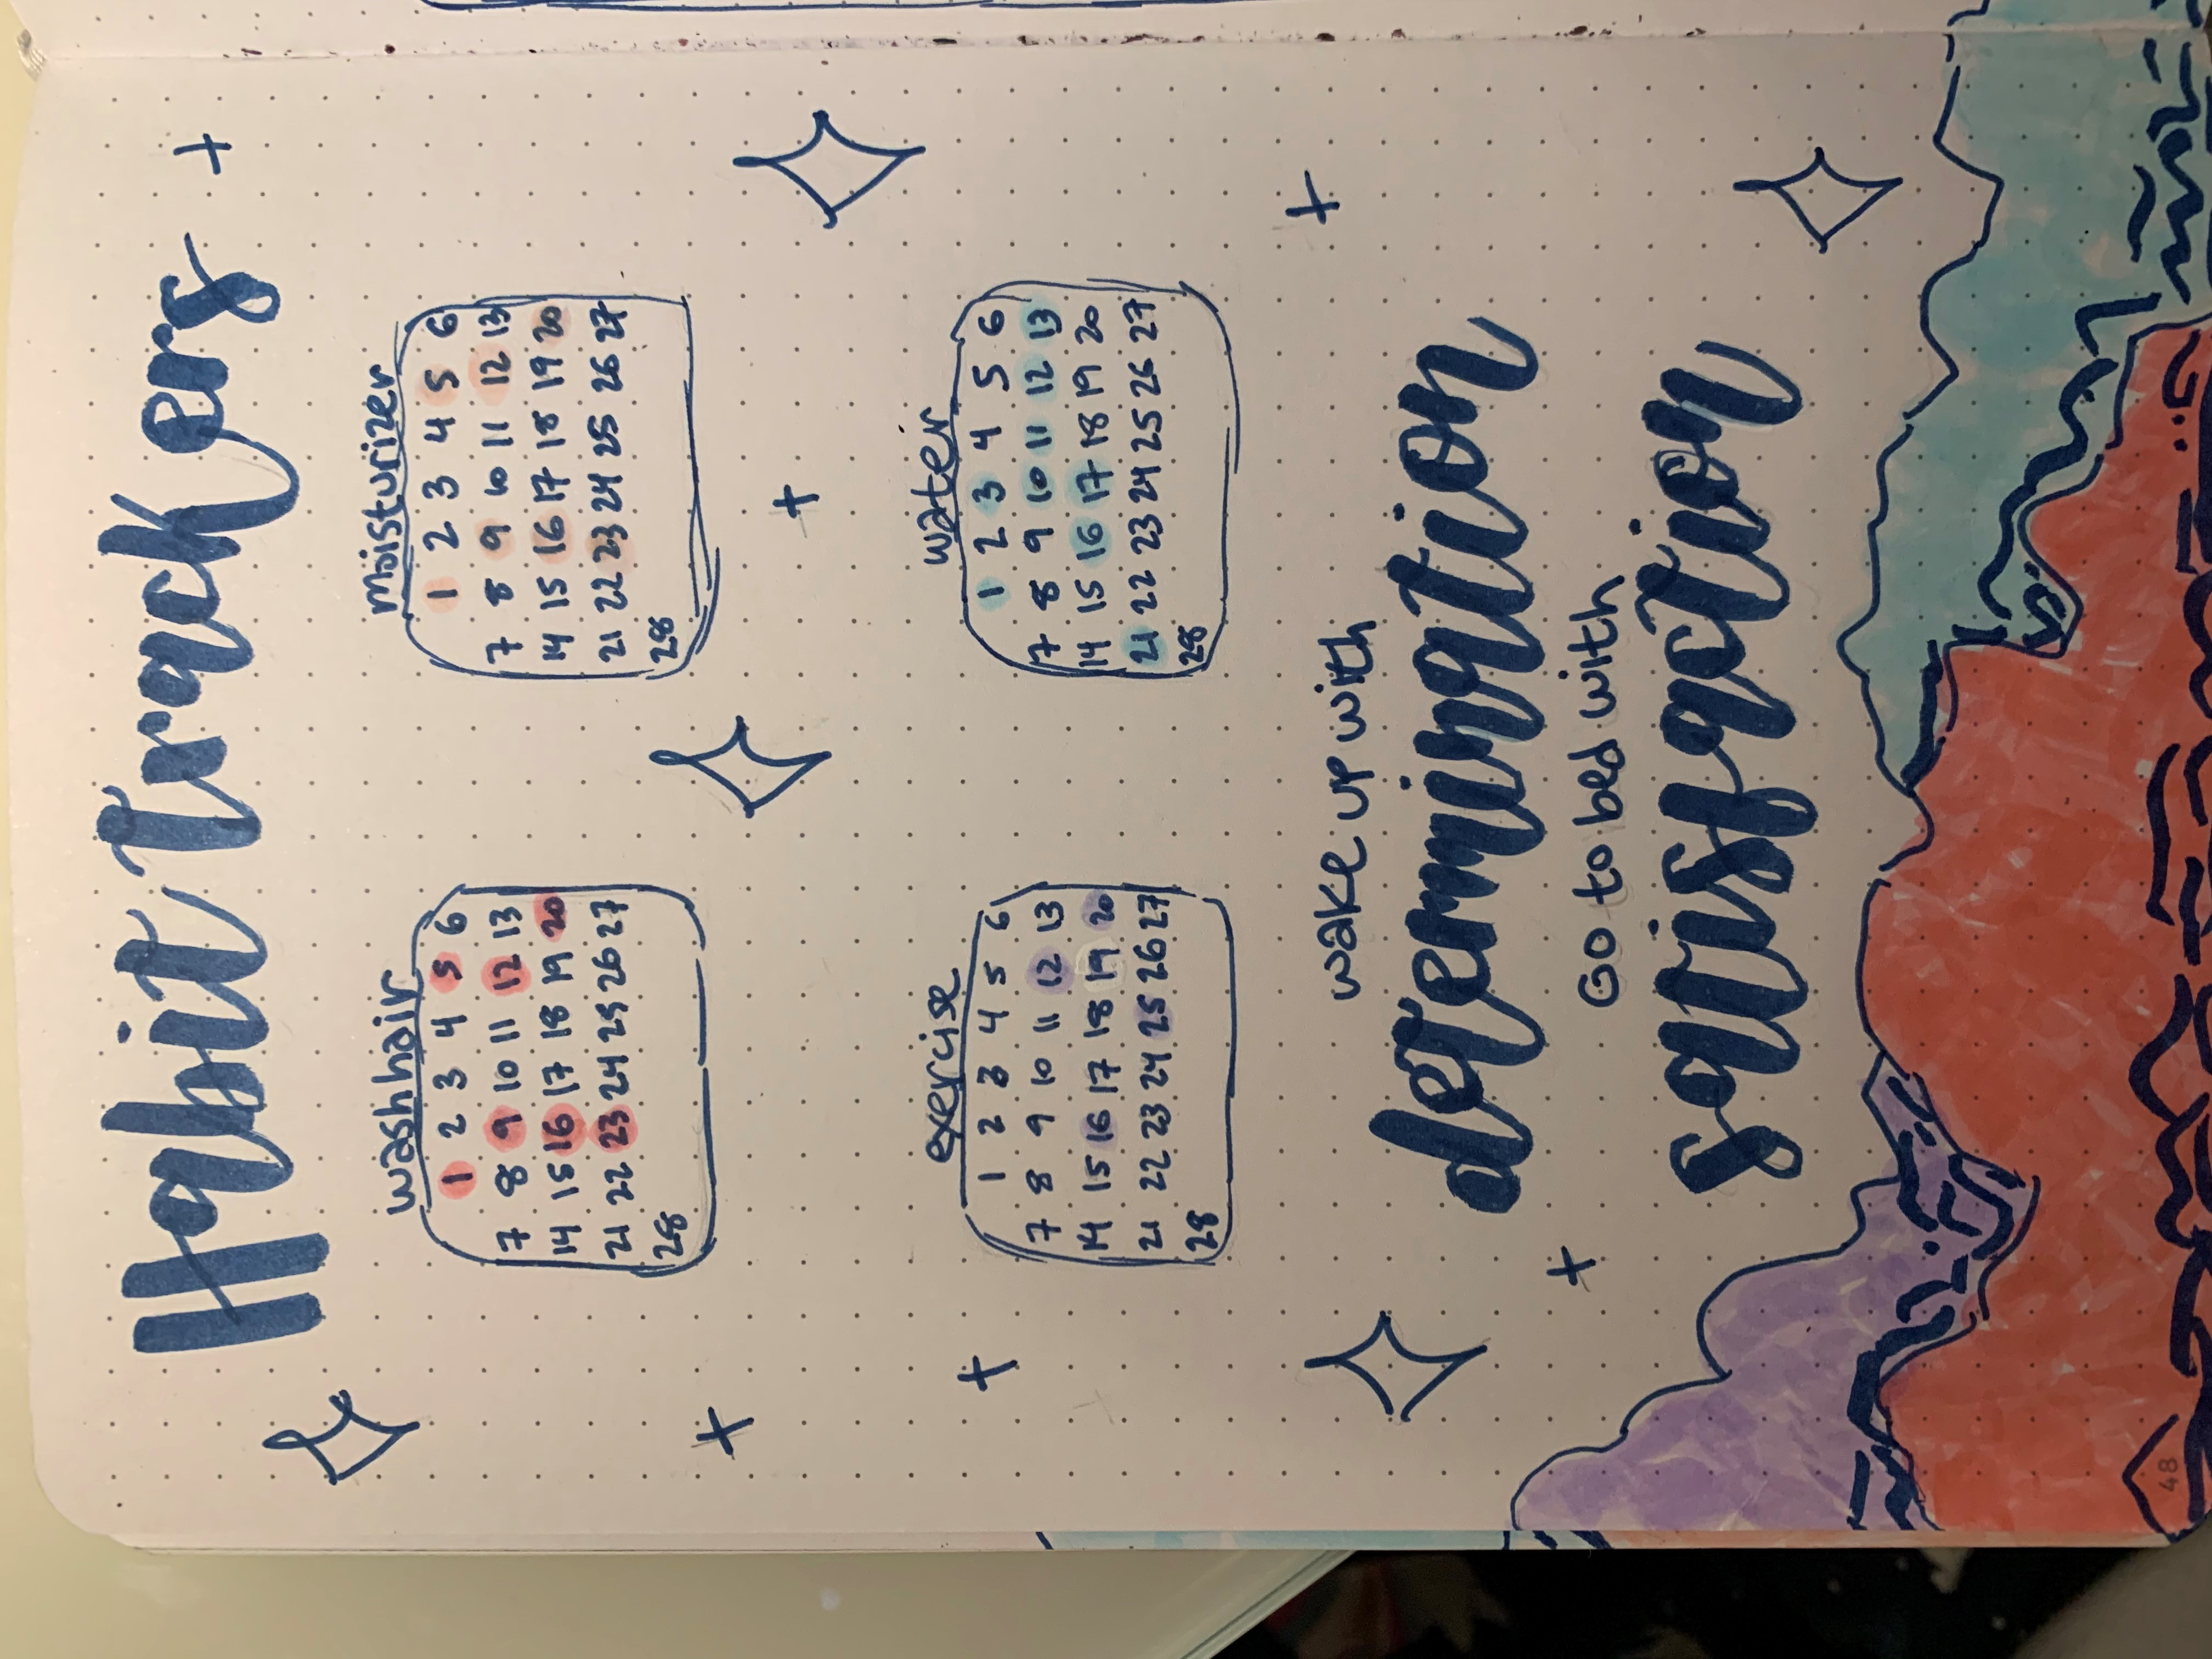
POSITIVE CONSEQUENCES AND REINFORCEMENT PLAN
NEGATIVE CONSEQUENCES
Requires planing and collaboration
Measurable
Flexible
Focus on positive, ignore negative
Reinforcers:
Natural
Social
Tangible
Token
Logical
Natural
Pre-established
Ignoring
Reparation/Restitution

Slide 8
IDEAS
FAMILY BONDING:
Family dinner
Movie night
Family hike
Game night
Family Olympics
EXPRESSING GRATITUTE :
Rose and thorns
Gratitude jar
Thank you jar
Journaling

Slide 9
BOOKS
The Whole-Brain Child: 12 Revolutionary Strategies to Nurture Your Child's Developing Mind. Daniel Siegel and Tina Payne Bryson
No Drama Discipline: The Whole-Brain Way to Calm the Chaos and Nurture Your Child's Developing Mind. Daniel Siegel and Tina Payne Bryson
Raising Your Spirited Child, Third Edition: A Guide for Parents Whose Child Is More Intense, Sensitive, Perceptive, Persistent, and Energetic. Mary Sheedy Kurcinka
Positive Discipline: The Classic Guide to Helping Children Develop Self-Discipline, Responsibility, Cooperation, and Problem-Solving Skills. Jane Nelsen
Positive Discipline for Teenagers, Revised 3rd Edition: Empowering Your Teens and Yourself Through Kind and Firm Parenting. Jane Nelsen
Untangle: Guiding Teenage Girls Through The Seven Transitions Into Adulthood. Lisa Damour
The Teenage Brain: A Neuroscientist's Survival Guide to Raising Adolescents and Young Adults. Frances Jensen
How to Raise Successful People. Esther Wojcicki

Slide 10
Welcome - Support - Advocate
Regional Champions Onboarding
Contact the Family Consultation Service at
familyconsultationservice@wbfn.org
+1-202-458-5550
www.wbfn.org
Session 1

