Slide 1
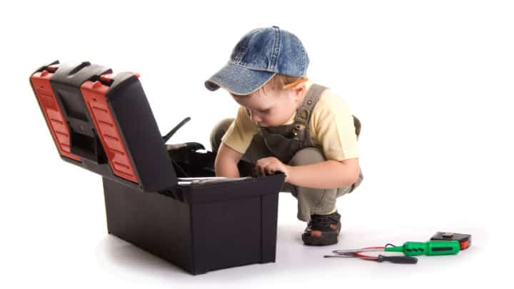
BUILDING YOUR PARENTING TOOLBOX
SESSION 4: Assembling the toolbox
Diana Mayer, LCMFT

Slide 2

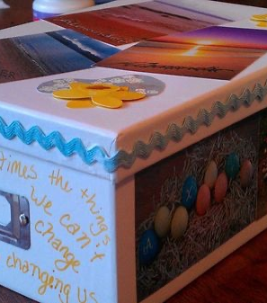
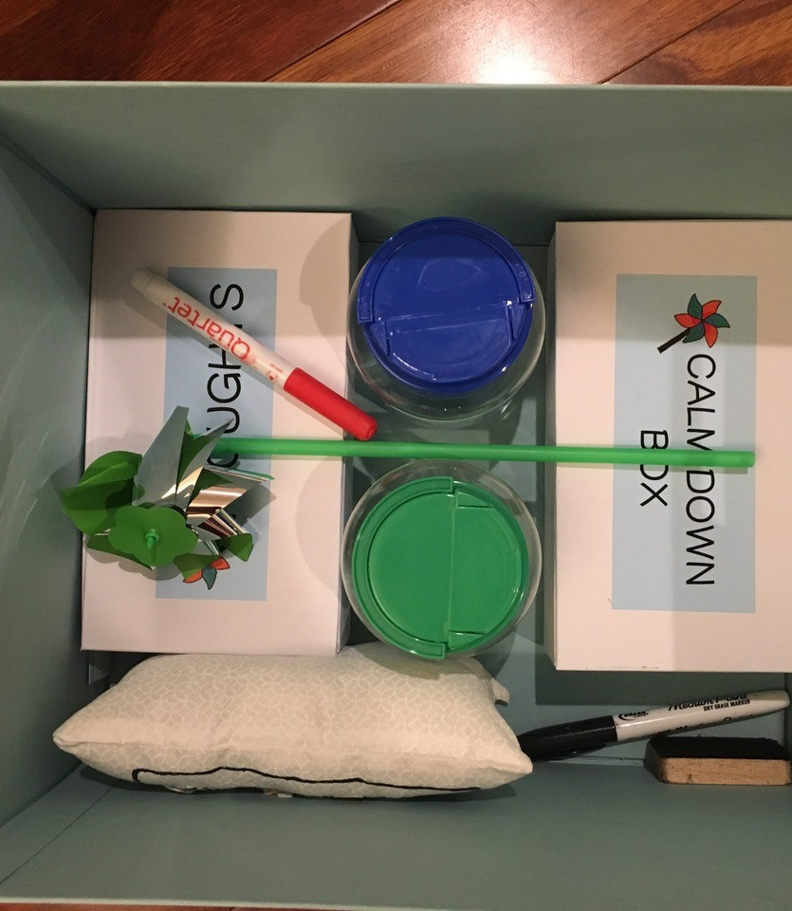
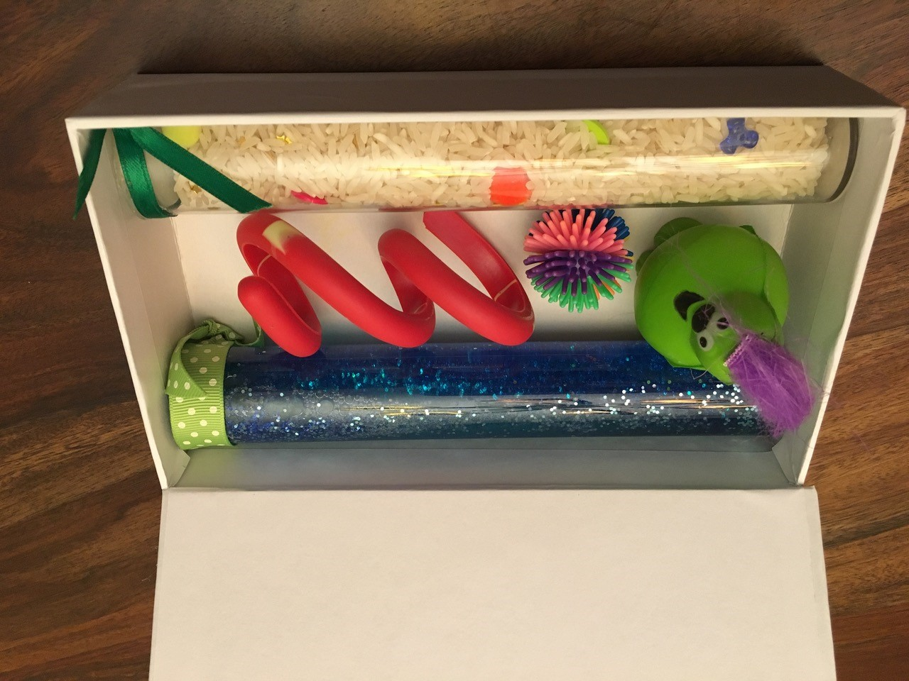
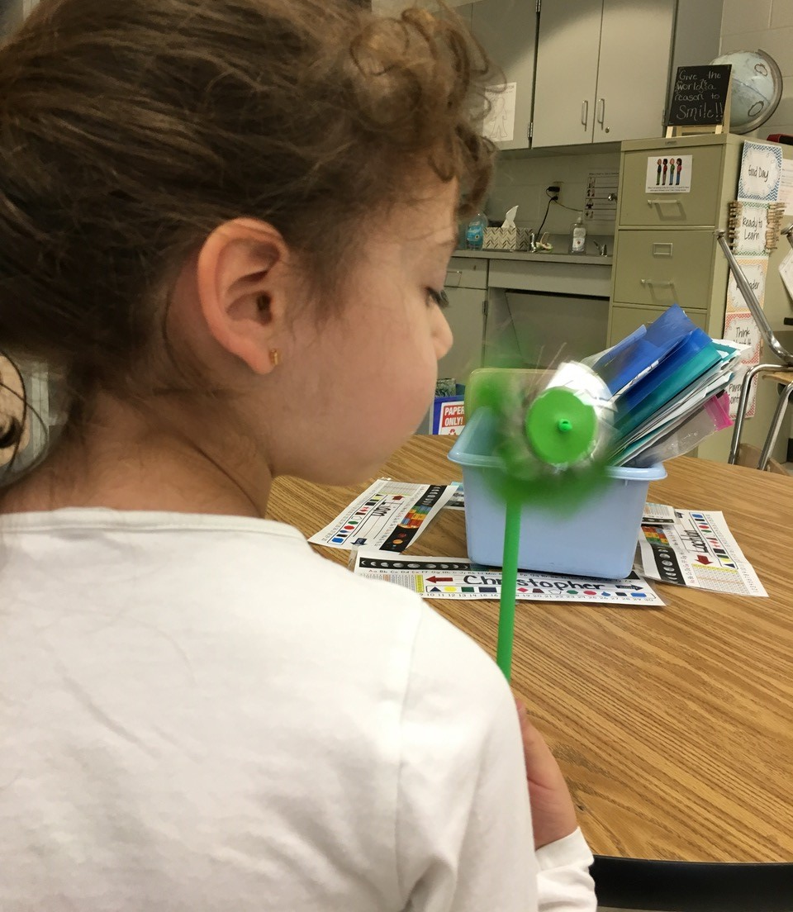
BUILDING THE TOOLBOX

Slide 3
IMPORTANT TIPS
Be a consultant to get buy in from your child
1
Be flexible. Tools may work just for a few weeks. Encourage trial and error
2
Reinforce every time your child uses the toolbox
3
Make it fun!
4

Slide 4


THE PARENTING TEAM
OPEN COMMUNICATION WITH YOUR PARTNER:
What attributes do you want to be able to use to describe your children in 20-years?
How would you know your parenting was succesfull?
What activities from today, will lead to your vision of success?
What are current issues, that if resolved, would make daily life easier?
BIG PICTURE
MAKE TODAY MANAGEABLE

Slide 5
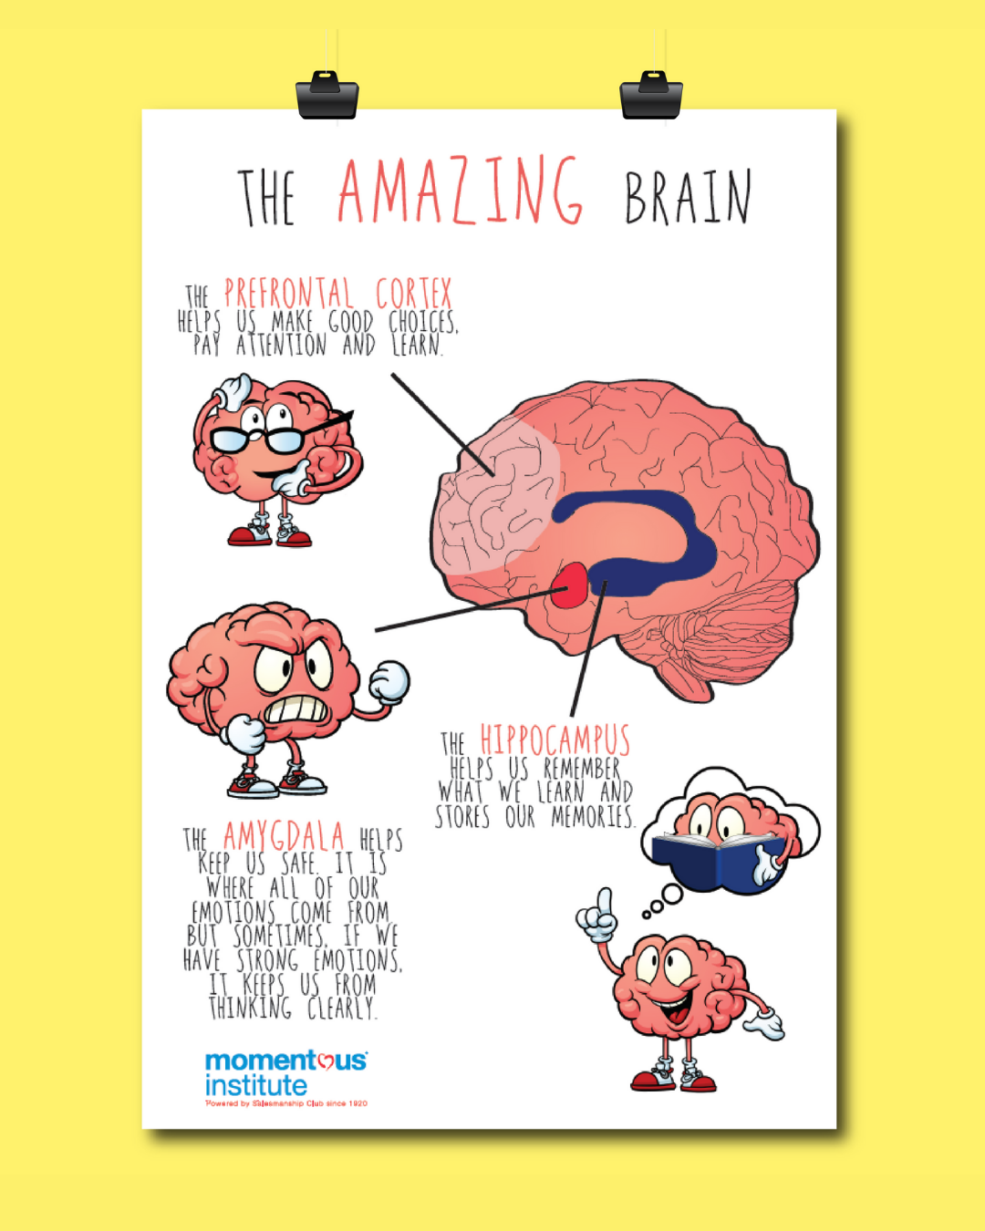
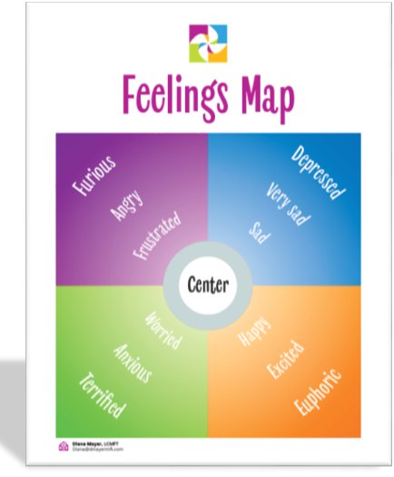
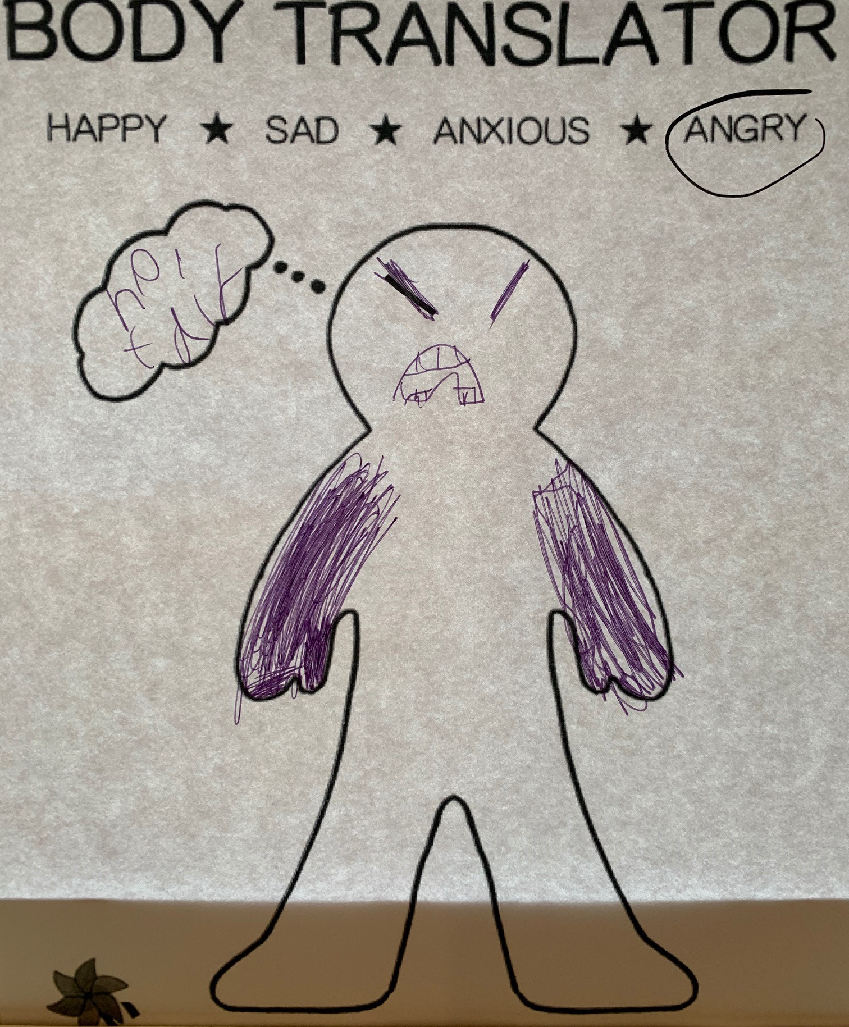
FOR EMOTIONAL REGULATION AND LANGUAGE

Slide 6

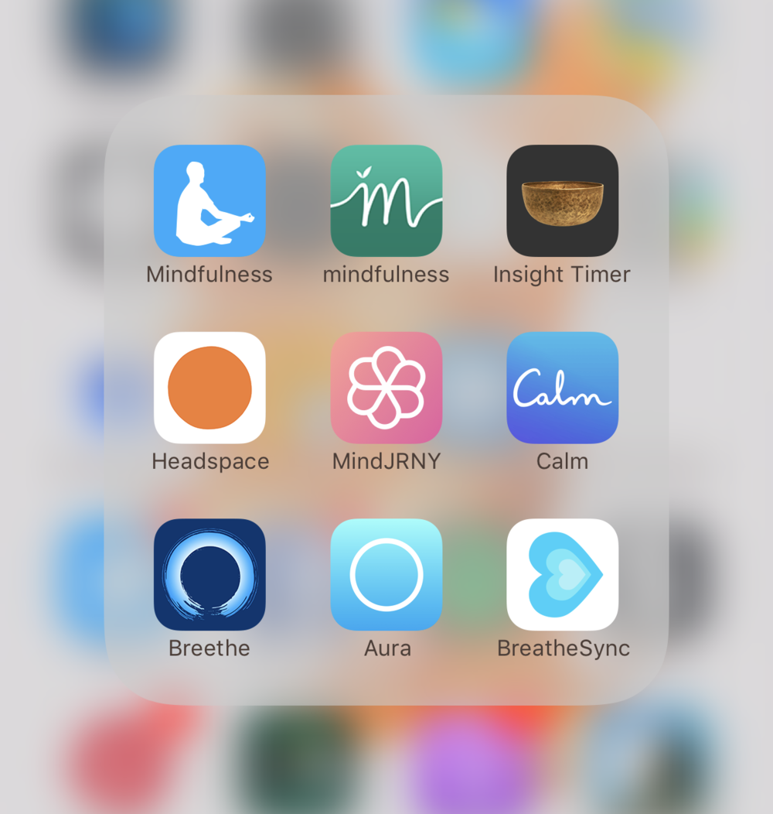
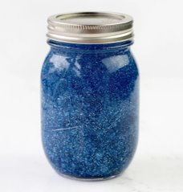
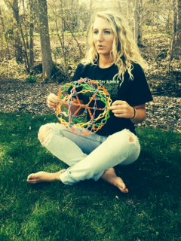

FOR BREATHING

Slide 7
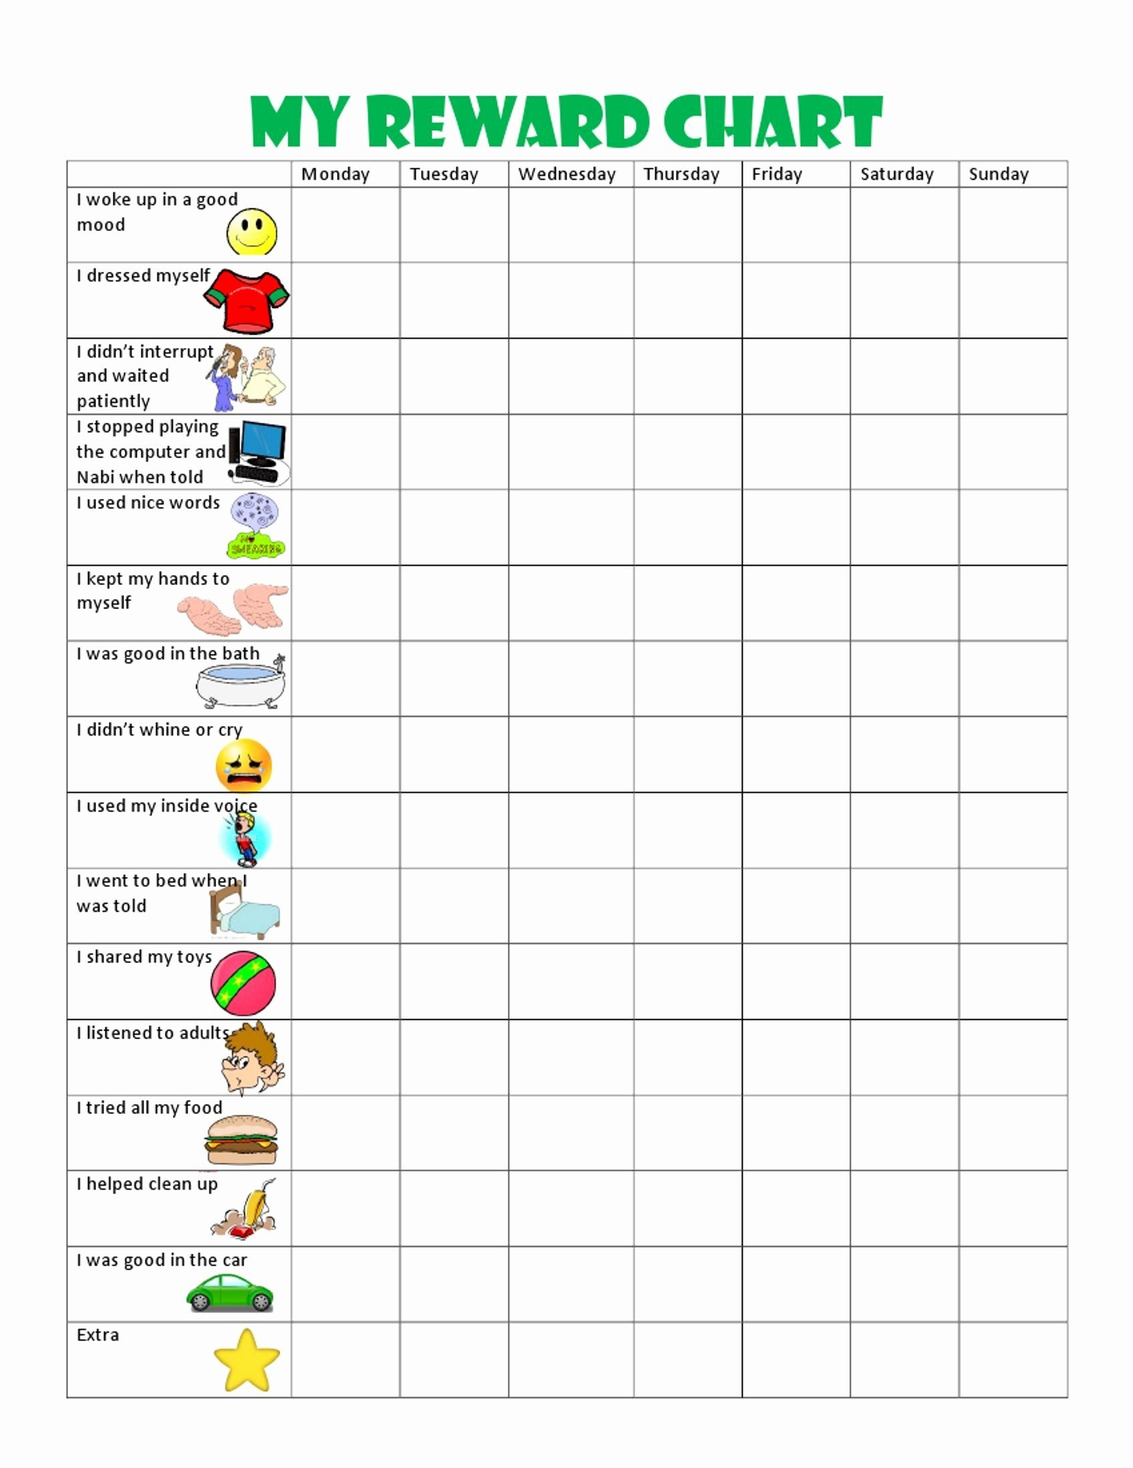
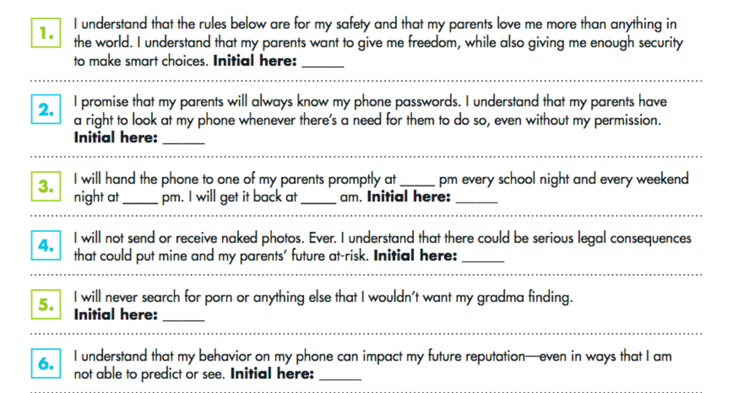
FOR DISCIPLINE
Relationship + Bonding come first

Slide 8
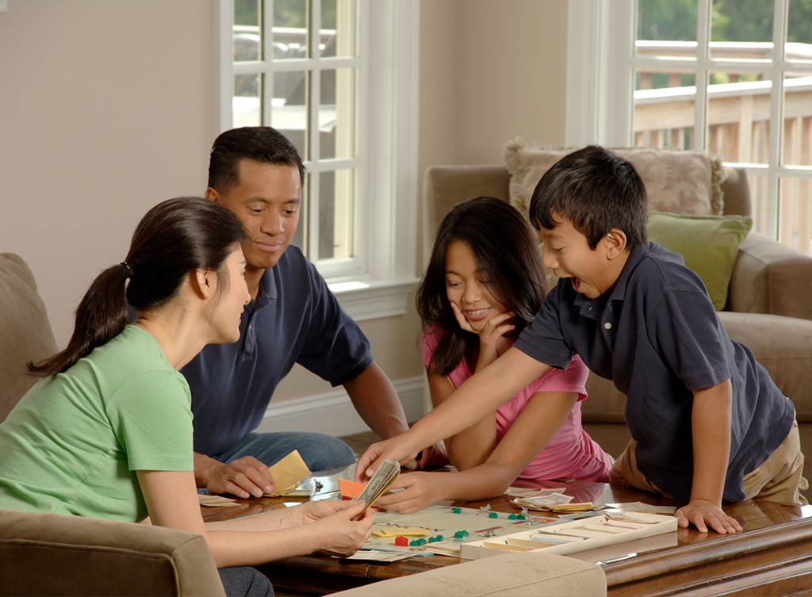



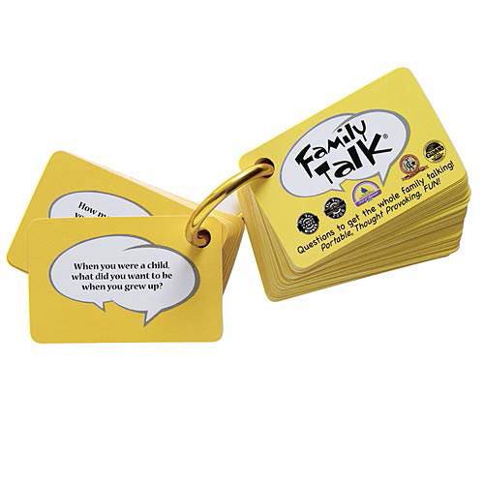
FOR BONDING AND APPRECIATION

Slide 9





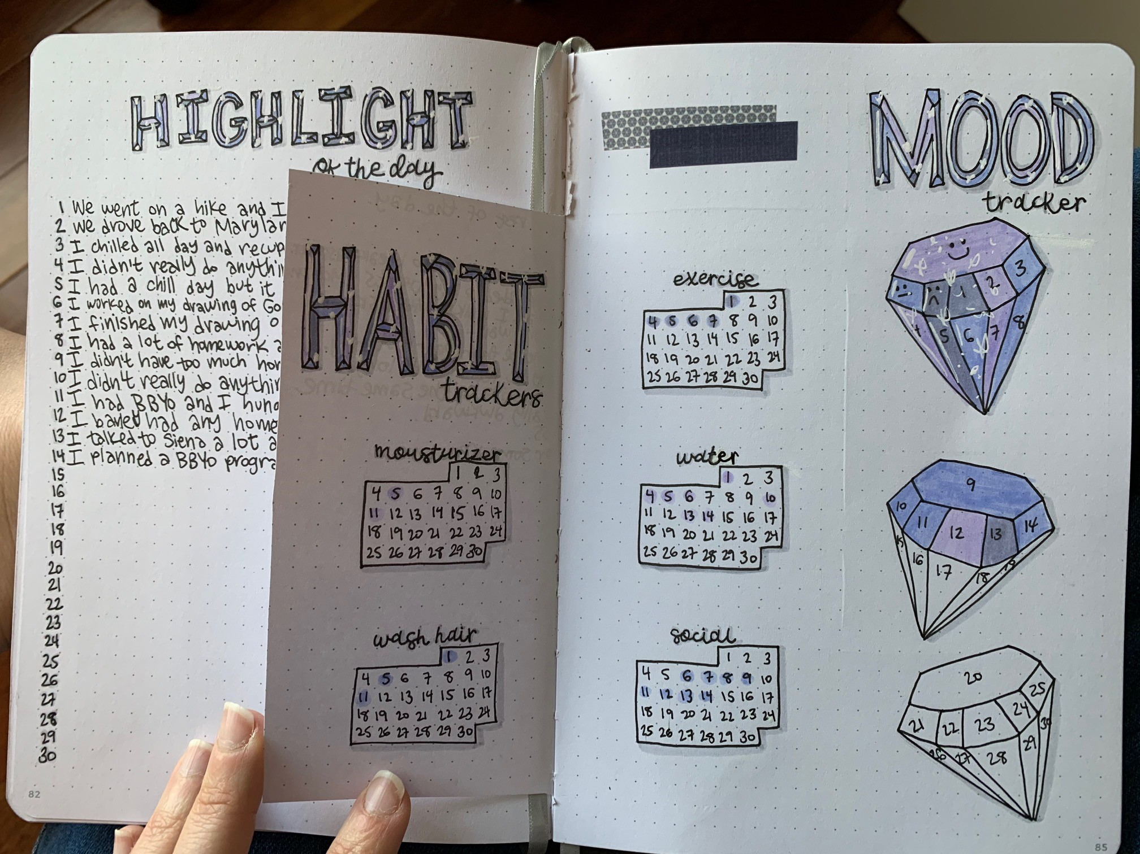
FOR SELF-DRIVE

Slide 10
FOR SELF-CARE
COME JOIN THE PARENTING LOUNGE!
Confidential
Conversational
Interactive
Learn from one another
Provide and receive validation, support and guidance
A space to build community
Small group. Pre-register!

Slide 11


Welcome - Support - Advocate
Regional Champions Onboarding
Contact the Family Consultation Service at
familyconsultationservice@wbfn.org
+1-202-458-5550
www.wbfn.org
Session 1

